Slide 1

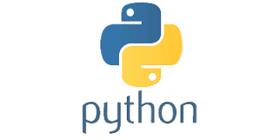
PYTHON
Lecture 19

Slide 2

Today’s Agenda
User Defined Functions
What Is A Function ?
Function V/s Method
Steps Required For Developing User Defined Function
Calling A Function
Returning Values From Function

Slide 3
What Is A Function ?
A function in Python is a collection of statements having a particular name followed by parenthesis .
To run a function , we have to call it and when we call a function all the statements inside the function are executed.
So we don’t have to write the code again and again
This is called code re-usability.

Slide 4
Function V/s Method
Functions are block of codes defined individually .
But if a function is defined inside a class , it becomes a method
So , methods and functions are same except their placement in the program.
Also we can call a function directly using it’s name but when we call a method we have to use either object name or class name before it

Slide 5
Function V/s Method
For example:
print(“hello”)
Here print( ) is a function as we are calling it directly
message=“Good Morning”
print(message.lower())
Here lower( ) is a method which belongs to the class str and so it is called using the object message

Slide 6
Steps Required For Function
To create and use a function we have to take 2 steps:
Function Definition: Creating or writing the body of a function is called defining it. It contains the set of statements we want to run , when the function execute.
Function Call: A function never runs automatically . So to execute it’s statements we must call it

Slide 7
Syntax Of Function Definition
def function_name(param 1,param 2, . . .):
statement(s)
Keyword def marks the start of function header.
It is followed by a function name to uniquely identify it.
Parameters (arguments) through which we pass values to a function. They are optional.
A colon (:) to mark the end of function header.
One or more valid python statements that make up the function body . All the statements must have same indentation level

Slide 8
Example Of Function Definition
def add(a,b):
print("Values are",a,"and",b)
c=a+b
print("Their sum is",c)

Slide 9
How To Call A Function ?
Once we have defined a function, we can call it from another function, program or even the Python prompt.
To call a function we simply type the function name with appropriate parameters.
Syntax:
function_name(arguments)

Slide 10
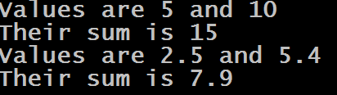
Complete Example
def add(a,b):
print("Values are",a,"and",b)
c=a+b
print("Their sum is",c)
add(5,10)
add(2.5,5.4)
Output:

Slide 11
Returning Values From Function
To return a value or values from a function we have to write the keyword return at the end of the function body along with the value(s) to be returned
Syntax:
return <expression>

Slide 12

Complete Example
def add(a,b):
c=a+b
return c
x=add(5,10)
print("Sum of 5 and 10 is",x)
y=add(2.5,5.4)
print("Sum of 2.5 and 5.4 is",y)
Output:

Slide 13

Exercise
Write a function called absolute( ) to accept an integer as argument and return it’s absolute value. Finally call it to get the absolute value of -7 and 9
Sample Output:

Slide 14
Solution
def absolute(n):
if n>0:
return n
else:
return -n
x=absolute(-7)
print("absolute of -7 is",x)
y=absolute(9)
print("absolute of 9 is",y)

Slide 15

Exercise
Write a function called factorial( ) which accepts a number as argument and returns it’s factorial. Finally call the function to calculate and return the factorial of the number given by the user.
Sample Output:

Slide 16
Solution
def factorial(n):
f=1
while n>1:
f=f*n
n=n-1
return f
x=int(input("Enter an int:"))
y=factorial(x)
print("Factorial of",x,"is",y)

Slide 17
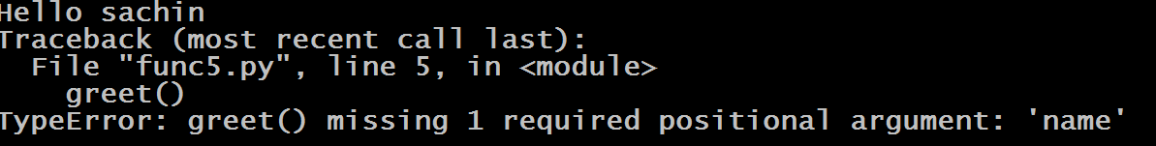
Guess The Output
def greet(name):
print("Hello",name)
greet("sachin")
greet()
Output:

Slide 18
Guess The Output
def greet(name):
print("Hello",name)
greet("sachin", "amit")
Output:

Slide 19

Guess The Output
def greet(name):
print("Hello",name)
return
print("bye")
greet("sachin")
Output:

Slide 20

Guess The Output
def greet(name):
print("Hello",name)
x=greet("sachin")
print("value in x is",x)
Output:

Slide 21
Returning Multiple Values From Function
In languages like C or Java , a function can return only one value . However in Python , a function can return multiple values using the following syntax:
Syntax:
return <value 1, value 2, value 3, . . . >
For example:
return a,b,c
When we do this , Python returns these values as a tuple, which just like a list is a collection of multiple values.

Slide 22
Receiving Multiple Values
To receive multiple values returned from a function , we have 2 options:
Syntax 1:
var 1,var 2,var 3=<function_name>()
Syntax 2:
var=<function_name>()
In the first case we are receiving the values in individual variables . Their data types will be set according to the types of values being returned
In the second case we are receiving it in a single variable and Python will automatically make the data type of this variable as tuple

Slide 23

Complete Example
Here Python will automatically set x and y to be of int type and z to be of tuple type
def calculate(a,b):
c=a+b
d=a-b
return c,d
x,y=calculate(5,3)
print("Sum is",x,"and difference is",y)
z=calculate(15,23)
print("Sum is",z[0],"and difference is",z[1])
Output:

